Slide 1
Serological reaction

Slide 2
Antigen-Antibody reaction is the specific combination of antigen and antibody. The antigen- antibody reaction invitro is called serological test.
Major uses of serological test
• Diagnosis of infectious disease
When the organism cannot be cultured Ex: syphilis and hepatitis A,B and C.
When the organism is too dangerous to culture. Eg: rickettsial disease.
When culture techniques are not readily available. Ex: HIV, EBV
- When the organism takes too long to grow. Ex: Mycoplasma
• Diagnosis of autoimmune diseases
- Antibodies against various normal body components are used. Ex: antibody against DNA in systemic lupus erythematosus, antibody against human IgG (rheumatoid factor) in rheumatoid arthritis.
• Determination of blood types and HLA type
Known antibodies are used to determine ABO and Rh blood types.
- Known antibodies are used to determine class I and class II HLA proteins prior to transplantation, although DNA sequencing is also being used.
• To identify and serotype a pathogen that has been isolated by culture.
Ex: V cholerae 01, group A streptococci, Salmonella species.
-To measure antibody level to determine prevalence, spread and control of infectious disease in community.

Slide 3
Characteristics of antigen antibody reaction
• Reaction is highly specific. However possible cross reactions between related antigens may occur.
• Antigenic determinant (Epitope) of antigen make contact with Hypervariable region (paratope) of Antibody and the molecules are held in key and lock arrangement.
• Combination is firm but reversible. Firmness is dependent on affinity and avidity.
• Only surface antigen participate.

Slide 4
Basic antigen-antibody reactions
• Precipitation reaction
• Agglutination reaction
• Labelled antibody assay
Radioimmuno assay
- Immunofluorescence assay
- Enzyme immuno assay
• Neutralisation test
• Complement fixation test

Slide 5
Precipitation test
In precipitation test, antibody combines with soluble antigens to form insoluble precipitate.
When precipitate remains suspended instead of sedimentation, the reaction is called flocculation.
This test is very sensitive as it can detect as little as 1 µg protein antigen.
Precipitation test can be performed in following ways;
Slide and tube precipitation test
Gel diffusion test
immunoelectrophoresis

Slide 6
Slide and tube precipitation test
• Ring test (done on tube): Here a clear solution of test antigen is layered onto a clear antiserum in a precipitin tube or capillary tube. After incubation, if there is Ag-Ab reaction in optimal proportion, a visible line of precipitation will be formed between the two layers of fluid. Ex: Ascoli’s thermoprecipitin test for CRP, Lancified method of grouping β-haemolytic streptococci.
• Flocculation test: Here antigen and antibody is mixed to observe visible clumping. It is done on slide (VDRL test for syphilis) and in tube (Kahn test for syphilis)

Slide 7
Gel diffusion test
It is done in gel and the precipitation is visible in the form of distinct band. Gel diffusion can be single diffusion or double diffusion.
1.Single diffusion: When only antigen or antibody diffuses with the corresponding antigen or antibody in the agar. The modifications of single diffusions are as following;
a. Single diffusion in one direction (Oudin procedure)
Here serum (antibody) is incorporated in agar gel in test tube and antigen solution is layered over it. Then antigen diffuses downward forming line of precipitation.
b. Single diffusion in two dimension (Radial immunodiffusion-Mancini method) :
Here Specific antibody is placed into agar gel and wells are cut in which antigens are kept. Antigens diffuse radially from the well. A ring of precipitation forms around a well that contains the corresponding antigen. This method is used to detect and measure antibody in serum like detection of IgM in CSF in trypanosomiasis meningoencephalitis.

Slide 8
2. Double diffusion
a. Double diffusion in one dimension (Oakley Fulthorpe procedure) Here serum (antibody) is incorporated in gel above which a column of agar is placed. Above the agar column, antigen is layered. Then antigen and antibody moves towards each other through plain agar and forms a band of precipitation.
b. Double diffusion in two dimension (Ouchterlony Procedure)
Here several wells are prepared in the agar of petriplate. Antibody (antiserum) is placed in the central well and different antigens are placed in surrounding well. These antigens and antibody diffuses and forms precipitin band where Ag-Ab meets.

Slide 9
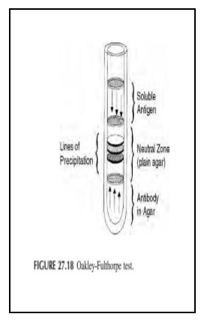
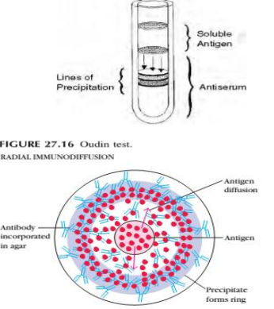

Slide 10
Immunoelectrophoresis
It is the combination of immunodiffusion and electrophoresis. This method consists of 2 stage;
Stage 1: here antigen is placed in a well present in agar gel on slide or plate. Electric current is passed through the agar and the antigens migrate in electric field according to the charge and size and thus separates from each other. Then current is stopped.
Stage 2: here trough is cut in gel parallel to the direction of antigen migration and it is filled with antibody. Then antigen and antibody diffuses towards each other and forms arcs of precipitation if they meet. Other examples of immunoelectrophoresis:
counter immunoelectrophoresis,
rocket immunoelectrophoresis

Slide 11
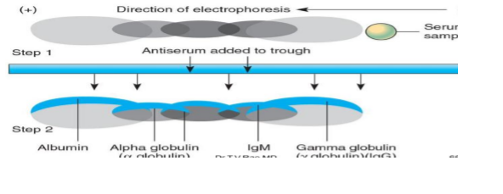

Slide 12
Agglutination reaction
It is the interaction between antibody and a particulate antigen resulting in visible clumping. Antibodies that produce such reactions are called agglutinins. This method is more sensitive than precipitation for detection of antibodies however their principle is same.
Agglutination can be performed in following ways;
-Slide agglutination test
-Tube agglutination test
-Microtitration agglutination test

Slide 13
Slide agglutination test
These are rapid, simple and widely used methods of agglutination test to detect antibodies or antigens. It is of 2 types direct or indirect (passive).
Direct agglutination test: It detects antibodies against relatively large cellular antigens, such as those on red blood cells, bacteria, and fungi. They usually form visible aggregates or clumps (agglutinates) that can be seen with the unaided eye. Ex: slide agglutination of Salmonella, Shigella or V cholerae, blood grouping and cross matching.

Slide 14
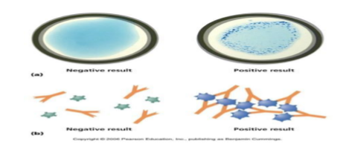

Slide 15
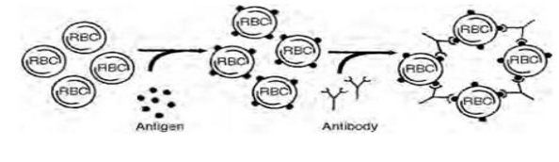
Indirect agglutination Test (Passive):
Specific antibody or known antigen is attached to inert carrier particles or cells (latex particle, carbon particle, stabilized staphylococcal cell). When a known antigen or antibody is added, they combine with their corresponding antibody or antigen in the specimen and hence the cells are agglutinated. Ex: RPR Test.

Slide 16
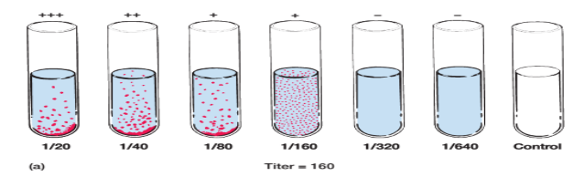
Tube agglutination test
Tube tests are more sensitive than slide test. They are used for determination of antibody titre and is routinely used for serological diagnosis of typhoid, brucellosis etc. Here, serum is diluted (in saline) serially by double dilution in a series of test tubes. An equal volume of standard antigen suspension is added to all tubes and then incubated. The highest dilution of serum at which visible agglutination occurs is recorded as antibody titre.

Slide 17
Microtitration agglutination test
These tests are done in microtitration plates and are very sensitive, easier and economical. They are replacing tube methods.
Examples;
- Indirect (passive) haemagglutination test (IHA)
Haemagglutination inhibition antibody test (HAI)
Reverse passive haemagglutination test (RPHA)
Indirect (passive) haemagglutination test (IHA): In this test, sensitized red cells (antigen coated red cells) are added to dilutions of patient’s serum. If serum contains the corresponding antibody in sufficient concentration, the red cells will be agglutinated and settle in the bottom of the well. This test is used in TPHA test to detect treponemal antibodies, ASO titration technique etc.
Haemagglutination inhibition antibody test (HAI): This test is used to detect antibodies against arbovirus, influenza virus, measles virus and rubella virus as these virus has haemagglutinin on their surface which can agglutinate red cells. Here patients serum is reacted with a suspension of known viral antigen. If the corresponding antibody is present, it will coat the haemagglutinins on viral particles due to which agglutination of red cells are prevented when added.

Slide 18
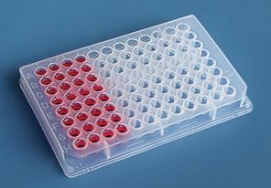

Slide 19
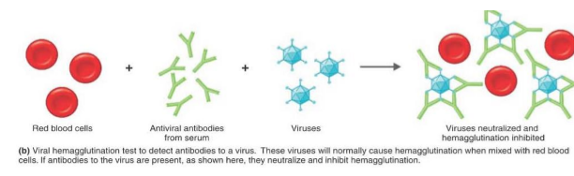

Slide 20
Reverse passive haemagglution test (RPHA): This test is used to identify viruses that donot haemagglutinate. It is performed by reacting viral specimens with red cells coated with specific viral antibody. If the corresponding antigen is present, the red cells will be agglutinated. Ex: detection of hepatitis B surface antigen.

Slide 21
Labelled antibody assay
Antibodies are labelled with specific markers for detection of antigens and haptens. These methods are sensitive and can detect picogram quantities of protein.
• Types
Radioimmunoassay (RIA)
Immunofluorescence
- Enzyme linked immunosorbent assay

Slide 22
Enzyme linked immunosorbent assay (ELISA):-
ELISA is commonly performed on polystyrene tubes (micro ELISA) or in polyvinyl microtitre plates (Micro ELISA).It uses enzyme system to show specific combination of antigen with antibody Enzyme/substrate system consists of
An enzyme (horse radish peroxidase, alkaline phosphatase) which is labelled, or linked to a specific antibody or antigen.
b. A specific substrate (O-phenyl-diamin-dihydrochloride for peroxidase, p-nitrophenyl phasphate for alkaline phosphatase) which is hydrolysed by enzyme to give a colored end product.
Types of ELISA
- Double antibody ELISA (Sandwich ELISA)
- Indirect ELISA

Slide 23
Double antibody ELISA (Sandwich ELISA)
• Antibody is coated on plastic surface.
• The solution to be tested for antigen is placed on antibody coated well and incubated for 2 hrs at 37°c. (the antibody specifically reacts with and immobilize the antigen molecules present in test solution.)
• Thorough washing with buffer is done to remove any untreated material.
• Then enzyme (alkaline phosphatase) linked second antibody (often the same antiserum as that coating the well except it is enzyme linked) is added and incubated at 37°c for 1 hr. (antigen in positive case is sandwiched between two antibodies)
• Wash with buffer.
• Substrate is added and left at room temperature till the positive control shows the development of specific color.
• The color in the reaction may be read visually or estimated calorimetrically using a micro assay plate reader (ELISA reader).
Intensity of color α amount of enzyme specifically bound to the well α concentration of antigen present in solution (specimen).Double antibody ELISA is useful for detection of Hep B surface antigen, hormones, toxins, HCG.

Slide 24
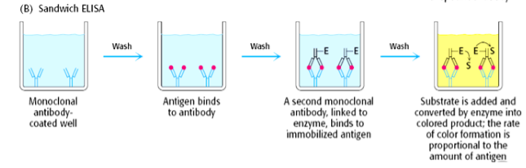

Slide 25
Indirect ELISA for antibody detection
• In this ELISA, sample of serum to be tested is applied to known antigen coated well in microtitre plate.
• The plate is incubated and washed.
• Then antihuman globulin labelled with an enzyme is added and incubated.
• The uncombined enzyme linked antibody is washed from the well and substrate is then added.
• Positive reaction is indicated by a change in colour of the substrate and the intensity of the colour is proportional to the concentration of antibody in the serum.
• Indirect ELISA is used in bacterial and fungal infections, HIV infections, diagnosis of several parasitic infections.

Slide 26
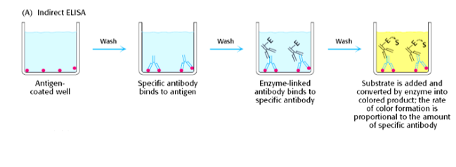

Slide 27
Radioimmunoassay (RIA)
RIA is performed when high specifity and sensitivity is required. It is done only in research laboratories that have equipments to measure radioactivity and have facilities of storage and disposal of radioactive material and its waste. It is generally used for measuring hormones, serum proteins, drugs, and vitamins at concentrations of 0.001 microgramsper milliliter or less.
Its principle is same as that of double antibody ELISA, except a radioactive compound is used instead of an enzyme i.e antigen or antibody is isotope labeled to detect and quantify antigen or antibody in test specimen using radioactivity

Slide 28
Immunoflorescent test(IFT)
It is also known as fluorescent antibody test (FAT). Here, fluorescent dyes (like fluorescin, Phycoerythrinis and rhodamines) are added to antibody and this antibody fluoresce when viewed under fluorescent microscope. IFT is used for identification of T and B cells in blood, detection of immunoglobulins, identification of Chlaymadia trachomatis in tissue etc. It is of two types: -
- Direct FAT test: Here, fluorescent dye is attached directly to antigen or antibody.
- Indirect FAT Test (Here, fluorescent dye is attached indirectly to antibody ie. Fluorescent labeled antiglobulin attached to antibodies.

Slide 29
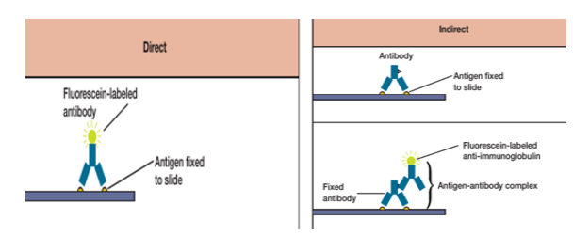

Slide 30
Complement fixation test
Complement is the protein can lyse the cells (RBCs, bacteria) .It get absorbed by the antigen-antibody complex.
The property of antigen antibody complex to fixed complement is used in the complement fixation test.
This test is used to detect and quantify antibody that doesn’t agglutinate or precipitate with it’s antigen.
Patient’s serum is serially diluted and reacted with known antigen in presence of complement. If there is corresponding antibody in the serum, it will combine with antigen and use complement. Due to this, there is NO HAEMOLYSIS of antibody coated red cells. However if the patient’s serum donot contain corresponding antibody, they wont be used i.e. the free complement is available to hemolyze the antibody coated red cells. Due to this there is HEMOLYSIS. Therefore, positive CFT= No Haemolysis and Negative CFT= haemolysis.
Complement fixation test is used for diagnosis of rickettsial , syphilis and several viral and parasitic infections.

Slide 31
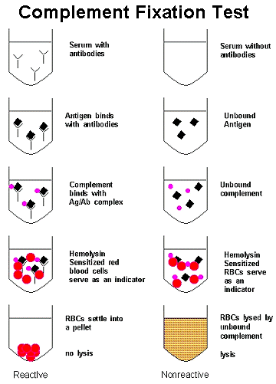

Slide 32
Neutralisation
A. Virus neutralization test
Neutralisation of viruses by their antibodies is called virus neutralization test. Can be demonstrated in various ways;
Example: Neutralisation of bacteriophages can be demonstrated by plaque inhibition test. When bacteriophages are seeded on appropriate dilutions on lawn culture of susceptible bacteria, plaques of lysis are produced. Specific antiphage serum inhibit plaque formation.
Examples: Neutralisation of animal viruses can be demonstrated in three system-animal, egg and tissue culture.
B. Toxin neutralization test
When an antibody combines with a toxin, the toxic effects of toxins are neutralized i.e the toxins become harmless to animals. Since toxins is an important antigen, it is also precipitated in solution.
Examples: Agar gel precipitation test to detect toxin of Corynebacterium diptheriae
Example: Neutralisation of streptolysin O by anti-streptolysin O in serum of patients infected with Streptococcus pyogens.

Slide 33
